Slide 1
Java for Beginners
RHS Boot Camp for Robotics Teams
July 7-10, 2015

Slide 2
Course Overview
Session 1 – Intro and variables
Java Intro
Software Basics
Simple Java Program – Exercise 01
Variables, assignment, types – Exercise 02
Primitives & References – Exercise 03

Slide 3
Course Overview (cont’d.)
Session 2 – operators, conditionals, looping
Arithmetic operators, increment/decrement, String concatenation, and assignment operators – Exercise 04
Conditional logic, if/else, switch – Exercise 05
Looping, for, while, do – Exercise 06

Slide 4
Course Overview (cont’d.)
Session 3 – Object oriented programming
Classes, methods/fields, constructors, access modifiers – Exercise 07
Inheritance, @Override – Exercise 08
Abstract classes – Exercise 09

Slide 5
Course Overview (cont’d.)
Session 4 – Arrays, List, Map, Interfaces
Arrays – Exercise 10
List<> – Exercise 11
Map<> – Exercise 12
Interfaces – Exercise 13

Slide 6
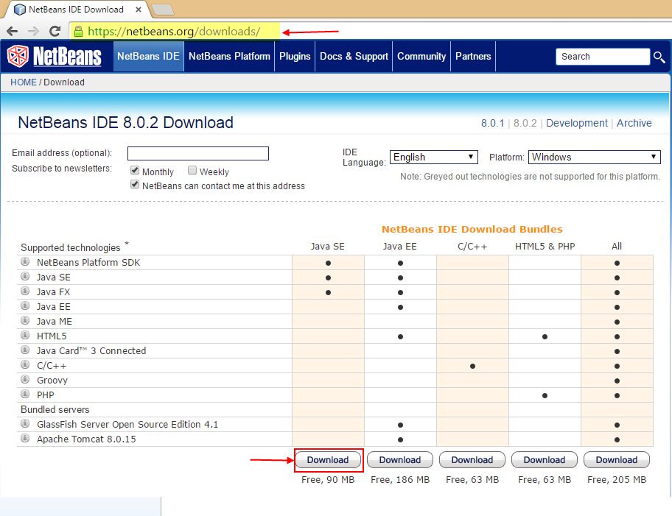
Download NetBeans IDE

Slide 7
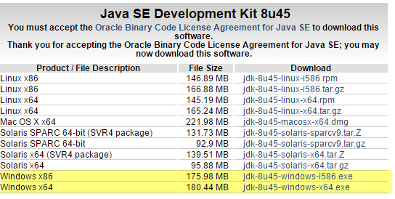
Download JDK
Internet search for: “JDK 8 Download”
http://www.oracle.com/technetwork/java/javase/downloads/jdk8-downloads-2133151.html

Slide 8
Why learn Java?
Java is the most widely used general purpose programming language
PCs, servers, phones/tablets, embedded devices
Multi-platform
Java was created as a “write once, run anywhere” language. A compiled Java program can run on Windows, MacOSX, multiple flavors of Unix.
Huge ecosystem of libraries
Developers have contributed open source libraries to aid in solutions for a wide range of problems: financial analysis, statistics, logging, database access, ad nauseum

Slide 9
How Java works
Java is platform independent because it runs on a Java Virtual Machine (JVM) rather than on the target platform directly.
Contrast with a language like C, which is compiled for each target platform and is not directly portable between platforms.
Java Source Code
(.java file)
Java compiler
Java Binary Code
(.class file)
JVM
Target computer
(PC, phone, etc.
Runtime

Slide 10
Exercise 01: Simple Program
Parts of program
Class file
Package
Class declaration
Main method
Comments
Print statement

Slide 11
Java variables
Variables are containers for values
Variables have a “type” which describes how the data that is stored should be interpreted.
Variable types
boolean, byte, char, double, float, int, long, short, String
Assignments are made with the assignment operator (=)

Slide 12
Java variable scope
Scope determines the part of the program over which a variable is defined
Variables can be defined in several places:
Class level - “Instance” (default) or “static”
As arguments of a method
Inside the body of a method
Inside a statement block, such as an if statement or while loop

Slide 13
Exercise 02: Variables, types, assignment
Explain types
Type conversions
Naming conventions
Cannot start with a number or special character
Cannot be identical to a keyword
Are case-sensitive
Must be declared before use
Normally use “camel case”

Slide 14
Primitives/References
Primitive variables contain a value and nothing more.
Reference variables are “objects”. In addition to values, they have “methods” which are functions that allow them to perform logic both on internal data and other values.
Of the basic Java types, only String is a reference type.
When checking equality of primitive variables, use the equality operator (==).
When checking equality of reference variables, use the equals() method. For reference types, == compares the object reference ids, rather than the value of the variable.

Slide 15
Exercise 03: Primitives/References
String methods
Checking equality of variables
Primitive object wrappers/ auto-boxing
Type conversion methods

Slide 16
Operators
Arithmetic operators: add (+), subtract (-), multiply (*), divide (/), modulo (%)
Increment (++) – increases integer value by 1
Decrement (--) – decreases integer value by 1
Change the order of evaluation of the increment/decrement operators by prefixing or suffixing the variable.
String concatenation
Assignment operators: compute and assign in one step

Slide 17
Exercise 04: Operators
Demonstrate operators
Use of debugger and breakpoints to inspect values in a running program

